Slide 1
Data Ingestion (ECDC Data)
From HTTP

Slide 2
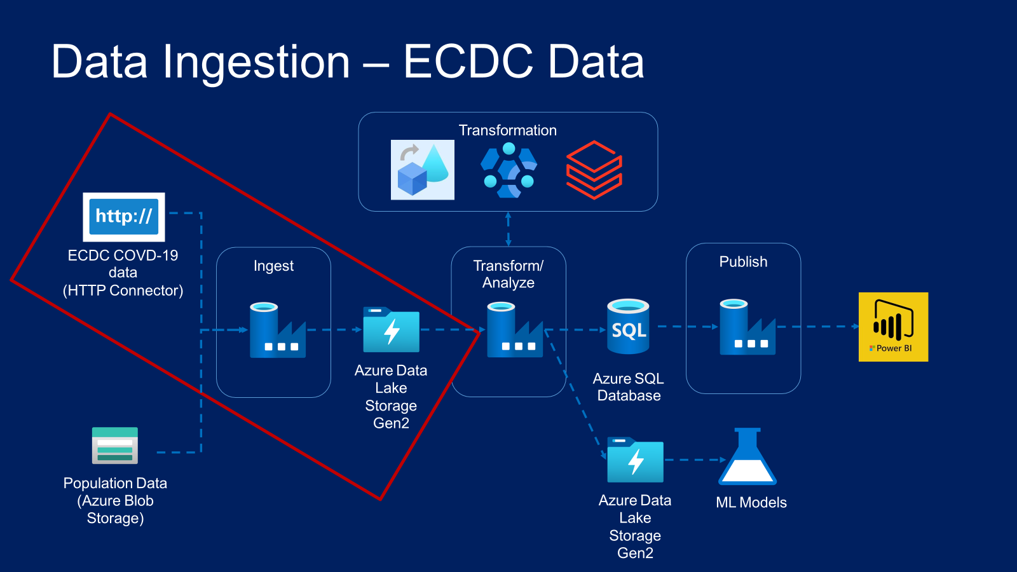

Slide 3
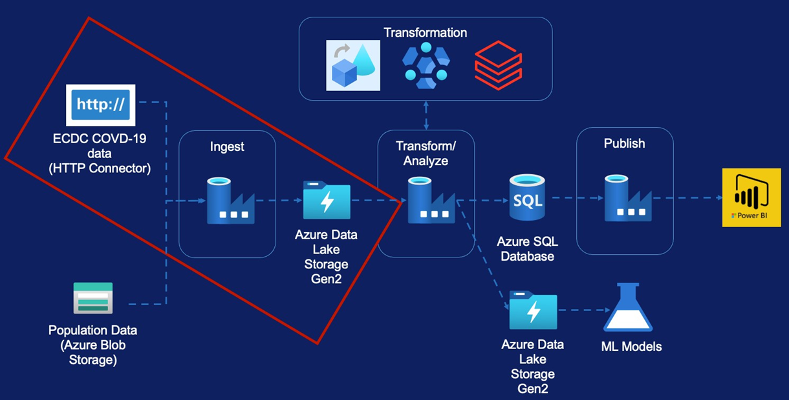
Data Ingestion- ECDC Data
ECDC Data Overview
Create Initial Pipeline
Pipeline Variables
Pipeline Parameters
Lookup Activity
For Each Activity
Linked Service Parameters
Metadata driven pipeline

Slide 4
Recent Changes to ECDC Data

Slide 5
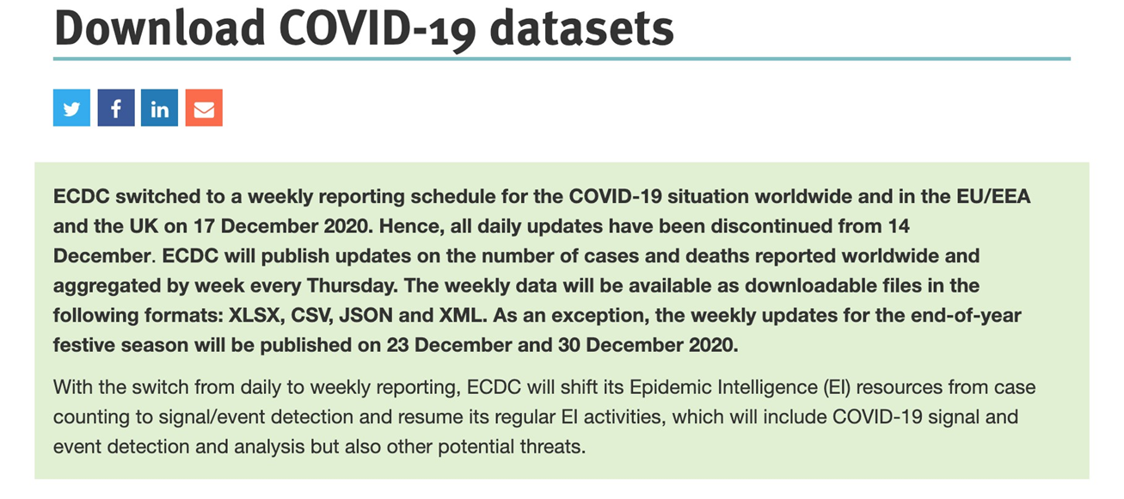
Granularity of the data changed from daily to weekly
File structure is also different as a result
Use GIT Repo - https://github.com/cloudboxacademy/covid19

Slide 6

Data Ingestion
HTTP
Azure Data Lake

Slide 7
Data Ingestion Requirement
Covid-19 new cases and deaths by Country
Covid-19 Hospital admissions & ICU cases
Covid-19 Testing Numbers
Country Response to Covid-19

Slide 8
Data Ingestion
Case & Death Data

Slide 9
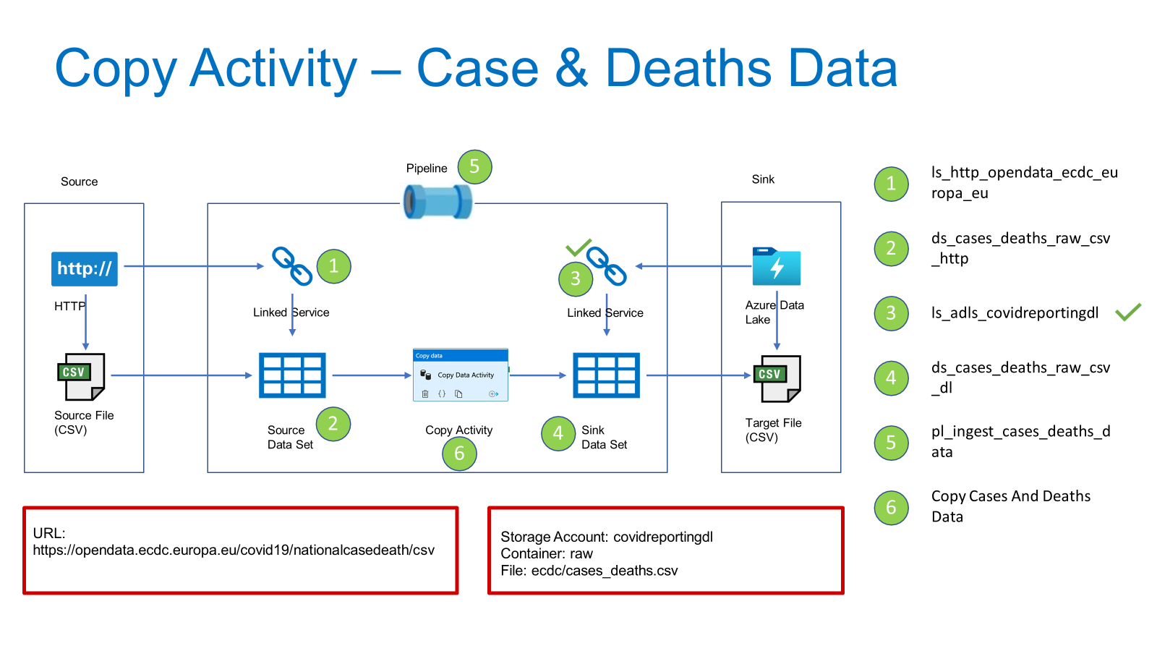

Slide 10
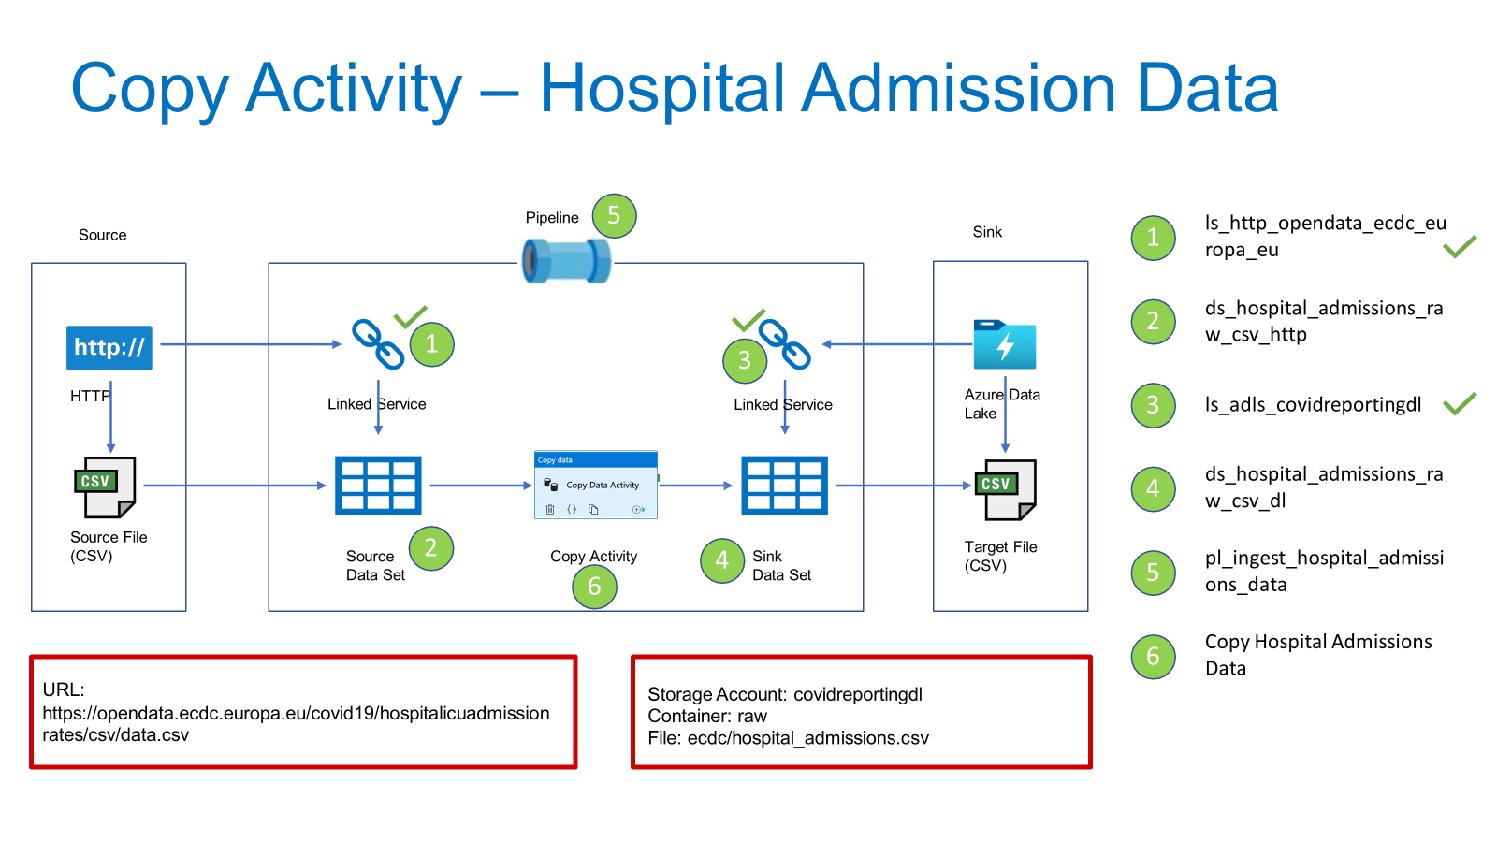

Slide 11
Parameters and Variables
Parameters are external values passed into pipelines, datasets or linked services. The value cannot be changed inside a pipeline.
Variables are internal values set inside a pipeline. The value can be changed inside the pipeline using Set Variable or Append Variable Activity

Slide 12
Thank You

